Slide 1

Fraud Transactions Analysis

Slide 2
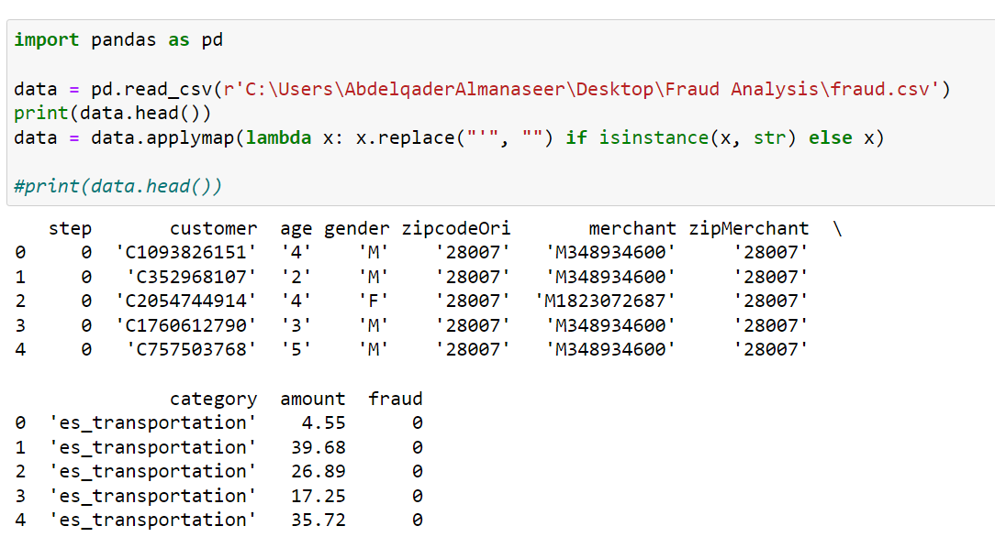
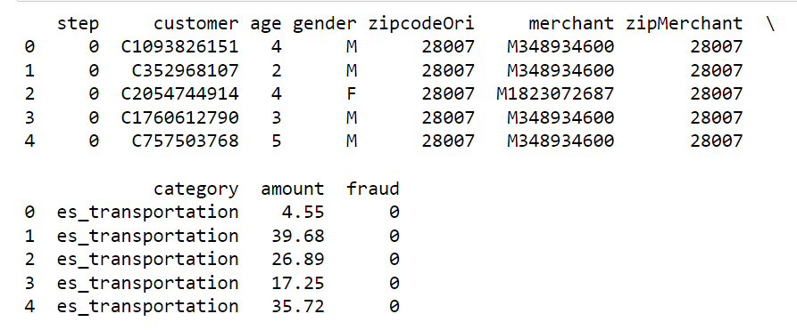







1. Used pandas library to load the CSV file.
2. Displayed the top rows to verify successful data reading and readiness for analysis.
3. Noticed single quotes in highlighted values, which might impact data quality, so decided it would be best to remove them.
Before
After

Slide 3
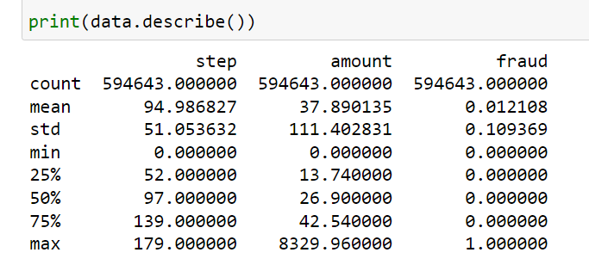
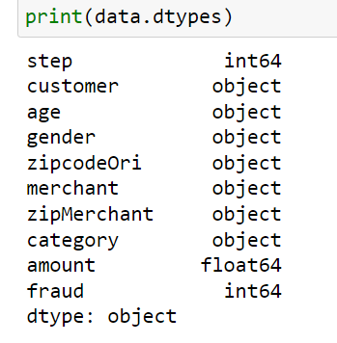
- Describe function for better data understanding (count,mean,min,max , …)
- Checking columns data types.

Slide 4
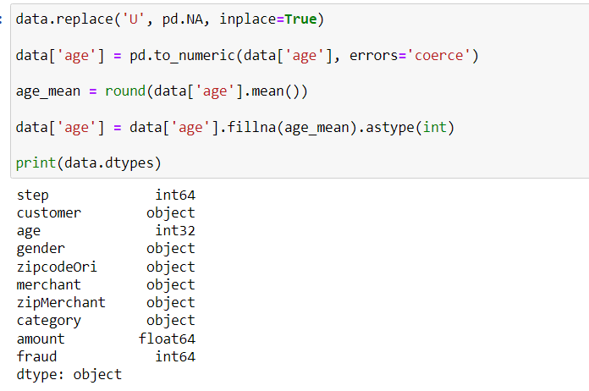
1. Handling missing values ‘U’ in [Age] column as they doesn’t exceed 5% of total values.
2. Replace 'U' with Nan for easier handling
3. Convert [Age] column to integer as integer allows for Nan values
4- Calculate the mean of the 'age' column and round it to the nearest integer as the data is normally distributed.
5 - Replace unknown values with the rounded mean.

Slide 5
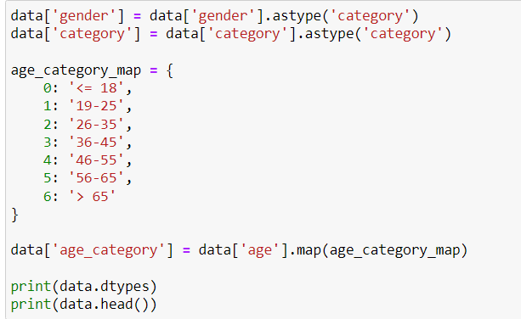
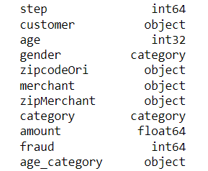
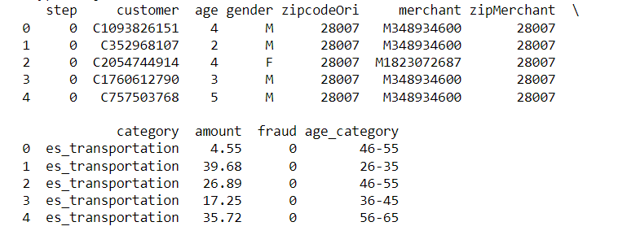
1- Changed [gender]&[category] data type to category as required.
2- Created new column for age category as required.
3- Displayed data types & sample to confirm that the changes were applied successfully.
Data Types:
Data Sample:

Slide 6
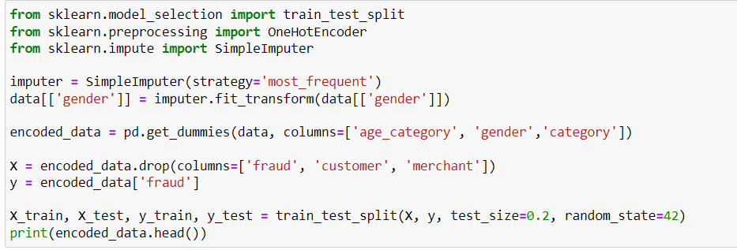
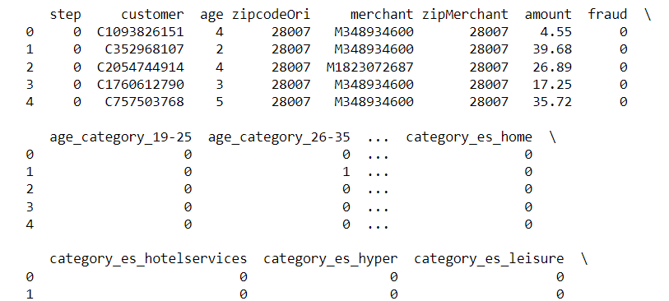
1- Imputed missing values for [gender] column.
2- For simplicity, I used mode imputation.
3- Encoded categorical variables using one-hot encoding as required.
4- Splatted dataset into features (X) and target variable (y).
5- Split into training and testing sets using 20% of data for testing.
- X_train and y_train contain features and target variable for training,
while X_test and y_test contain features and target variable for testing/validation.

Slide 7
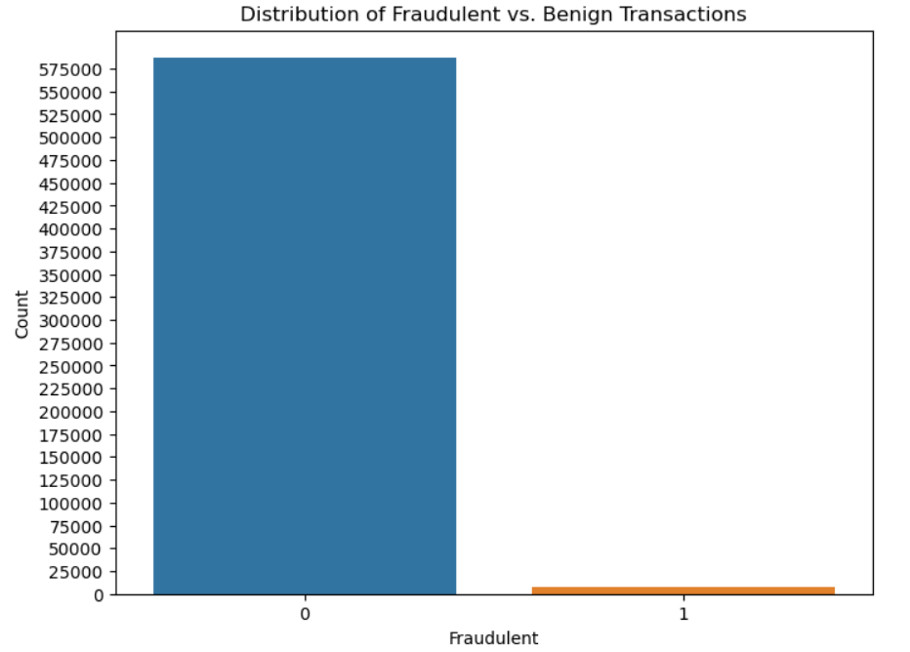
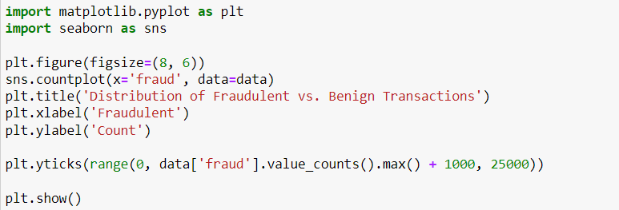
1- Exploring the distribution of the target variable (Fraud).
2- Using matplotlib.pyplot & seaborn libraries to visualize the result
0 = Benign Transaction
1 = Fraud Transaction

Slide 8
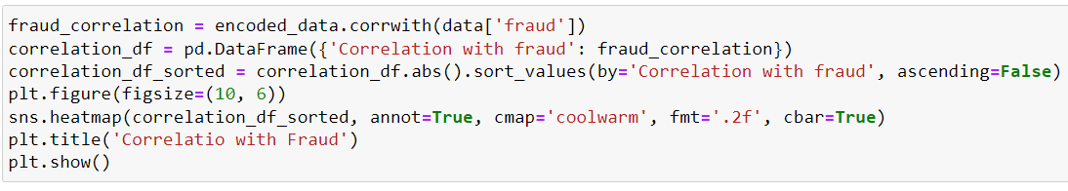
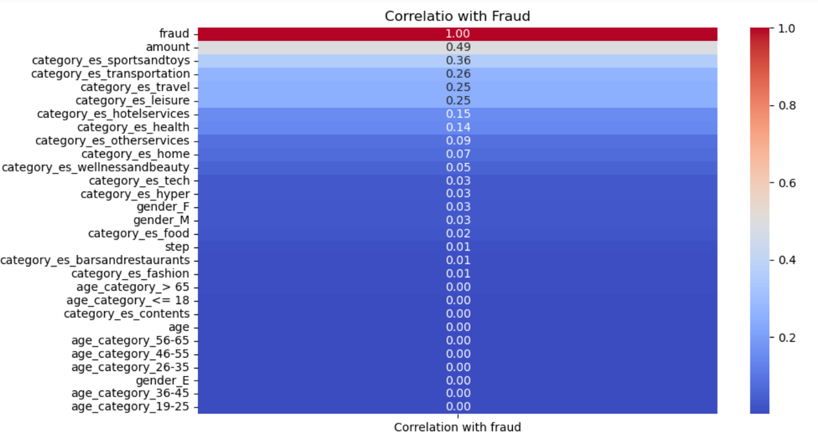
Analyzing the distribution of features and their relationships with the target variable (fraud).
We notice that amount has highest positive correlation with the fraud.

Slide 9
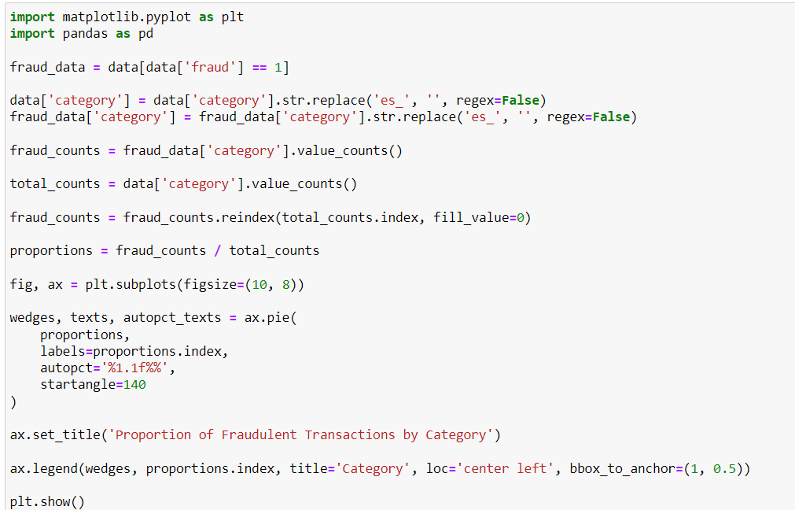
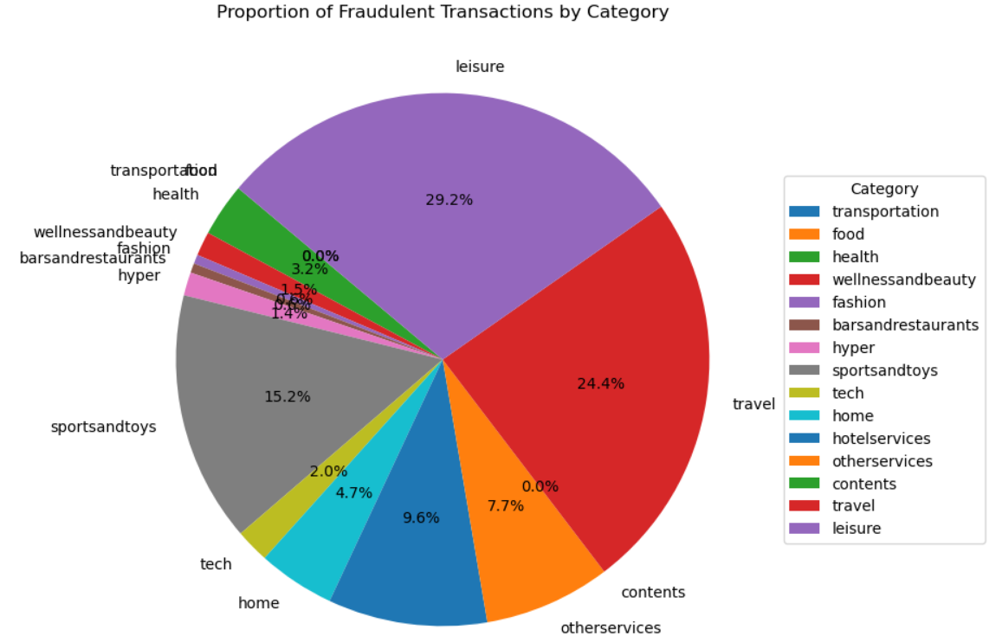
Pie chart showing the proportion of fraudulent transactions by each category to identify what are the highest categories used for fraudulent transactions.

Slide 10
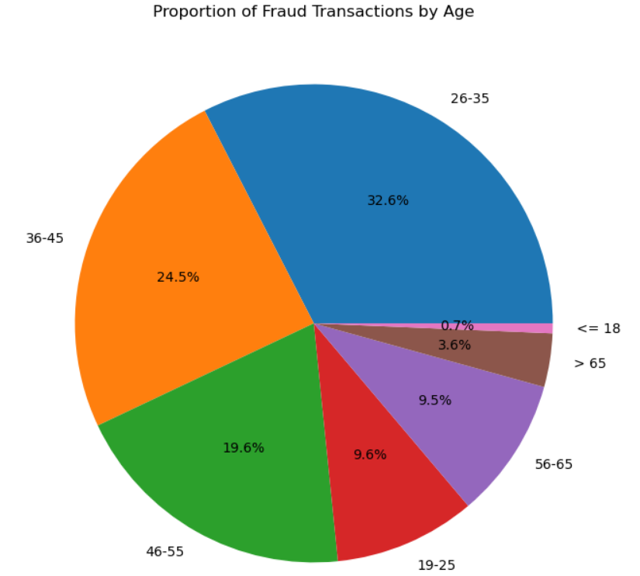
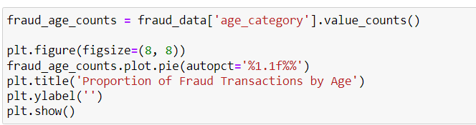
Pie chart showing the proportion of fraudulent transactions by each age category to identify what are most common ages in the fraudulent transactions.

Slide 11
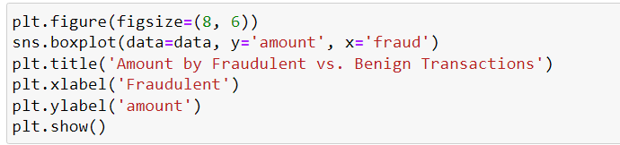
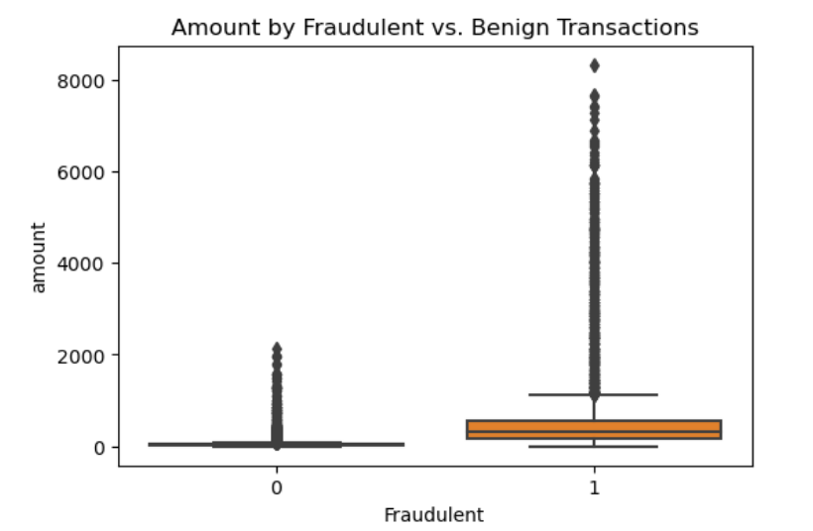
Using Boxplot to check for potential outliers in the data

Slide 12
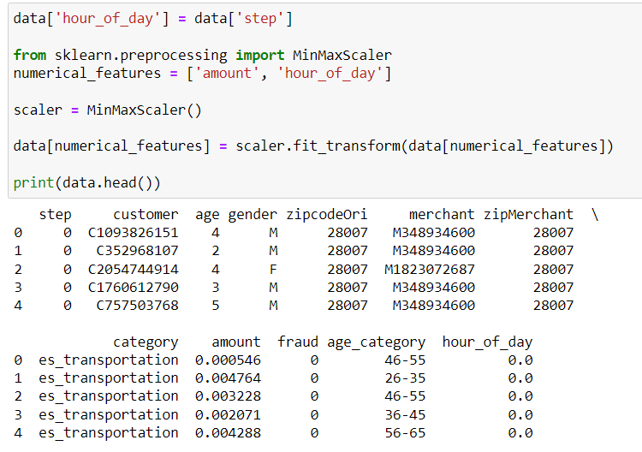
1- Created new relevant features from step (hour of day)
2- Used MinMaxScaler from sklearn.preprocessing library to normalize the numerical feature.
3- Displayed the first few rows of the updated dataframe to verify changes.

Slide 13
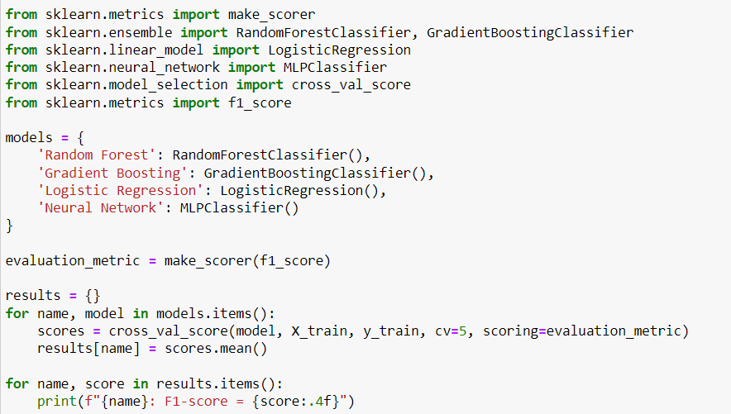
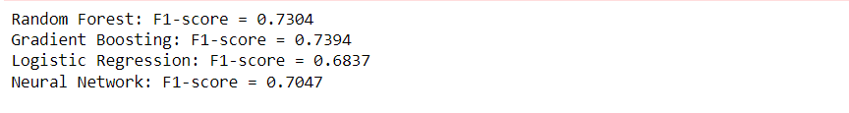

1- Imported the models that will be evaluated.
2- Defined the models.
3- F1-score is a suitable metric for imbalance dataset.
4- Evaluated models using cross-validation.
5- Displayed the results as below the code.
* F1-scores provide an indication of each model's performance in terms of both precision and recall, with higher scores indicating better performance.

Slide 14
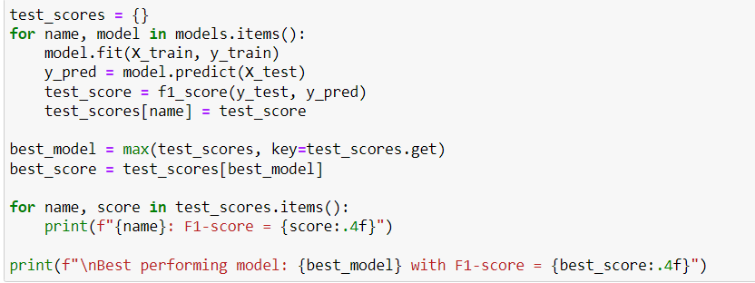
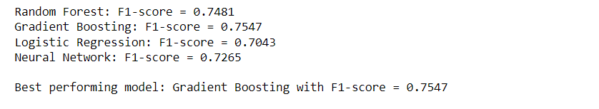

1- Evaluating models on test data (20% of all data).
2- Fit the model to the training data.
3- Predict the target variable for the test data.
4- Calculated the F1-score.
5- Compared the models performance.
6- Displayed models performance.

Slide 15
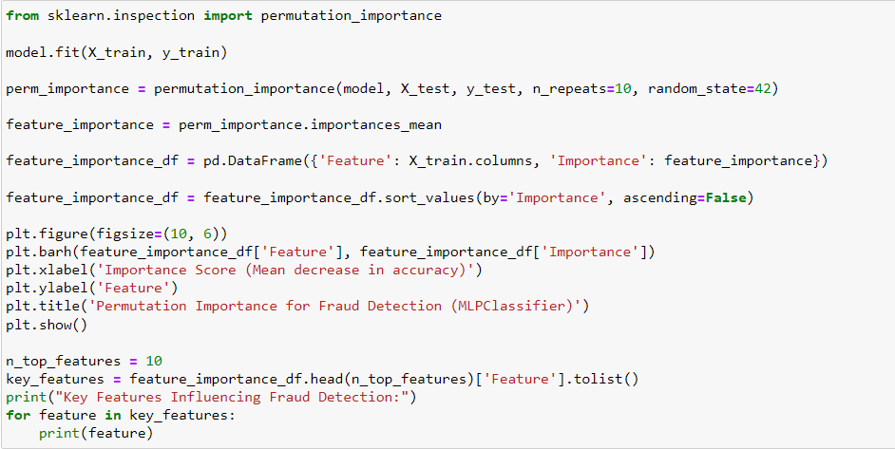
1- Fit the MLPClassifier model to the training data.
2- Calculated permutation importances.
3- Get feature importances.
4- Created a Data Frame to store feature names and their importance scores.
5- Sorted features by importance scores in descending order.
6- Visualize feature importance.
7- Identified top 10 key features.
Result

Slide 16
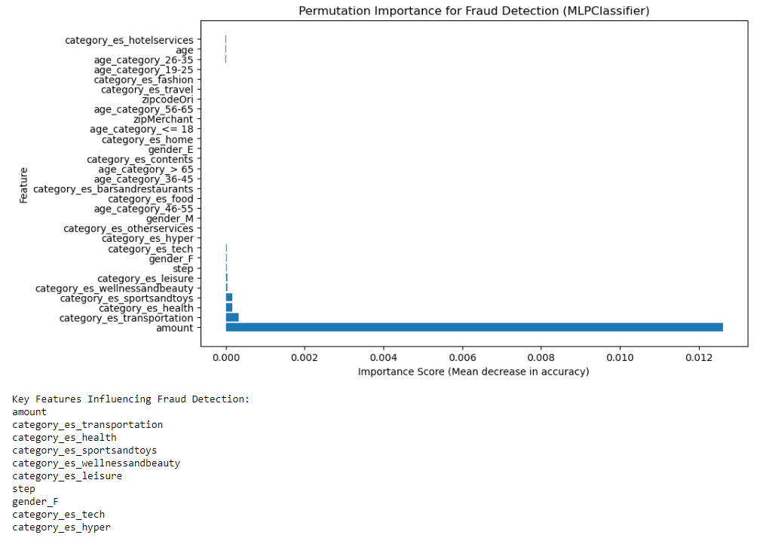

Slide 17
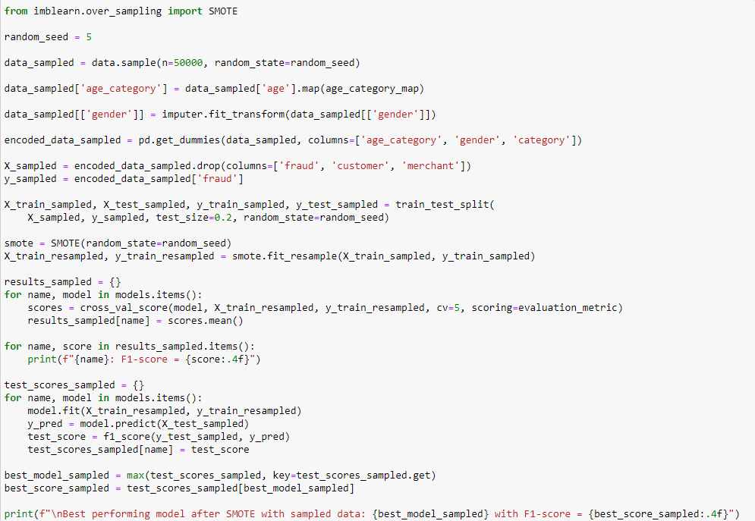
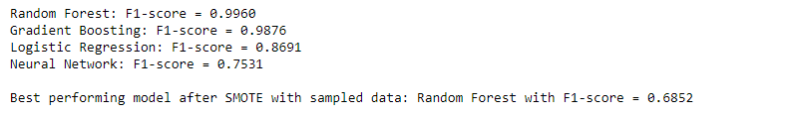
1- Sat random seed 42 for reproducibility and 50,000 rows randomly.
2- Converted categorical data and handled missing values.
3- Splatted the data into features and target (excluded customer and merchant as they are identifiers).
4- Splatted the data into training and testing sets.
5- Applied SMOTE class imbalance technique to the sampled data.
6- Trained the models with the resampled data.
7- Displayed the models scores.
8- Evaluated the models on the test data.
9- Determined the best model and its score.
10- Displayed the best performing model and its F1-score.

Slide 18
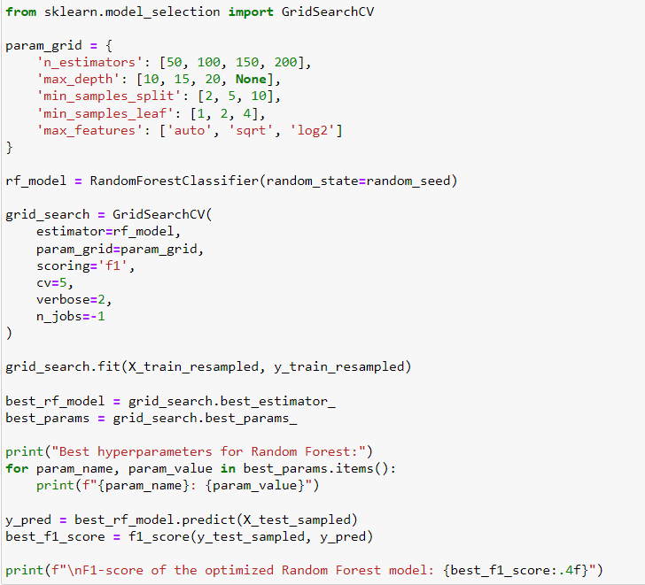
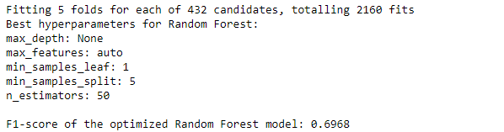
1- Defined the hyperparameter grid.
2- Initialize the Random Forest model.
4- Fitted the GridSearchCV object to the training data.
5- Got the best model and hyperparameters.
6- Displayed the best hyperparameters.
7- Evaluated the best model on the test data.
8- Displayed the F1-score of the best model.
3- Create a GridSearchCV object.

Slide 19
Key Outcomes :
1- Model Performance:
The Random Forest model was identified as the best performing model for predicting fraud with an F1-score of 0.6839 on the test data after applying SMOTE and hyperparameter tuning.
The other models (Gradient Boosting, Logistic Regression, and Neural Network) also showed promising F1-scores, indicating their potential in fraud detection.
1- Important Features:
The analysis identified key features influencing fraud detection:
amount was a critical factor in determining whether a transaction is fraudulent.
Specific categories such as health, tech, and hyper were significant in predicting fraud.
Age categories (26-35, 19-25) were also important.
Other categories such as home, fashion, and leisure played a role in predicting fraudulent behavior
Recommendations

Slide 20
Recommendations:
1- Real-Time Fraud Detection:
Implement real-time monitoring systems to detect suspicious transactions as they occur.
Use the fraud detection model to flag potentially fraudulent transactions for immediate review.
2- Customer Education :
Educate customers on best practices for securing their personal and financial information.
Provide guidance on recognizing phishing attempts and other common fraud schemes.
1- Other Recommendations:
Develop customer risk profiles based on transaction history and other relevant data.
Implement risk scoring for transactions based on factors such as amount, location, frequency, and category.
Regularly review and update fraud prevention strategies based on new insights and emerging trends.
Document Additional Customer-Related Data such as(Transaction Location, transaction channel, Device and Network Information)

Slide 21
Thank You

